Slide 1


Image Representation

Slide 2

Learning Objectives
Explain the representation of an image as a series of pixels represented in binary
Explain the need for metadata to be included in the file such as height, width and colour depth
Discuss the effect of colour depth and resolution on the size of an image file

Slide 3
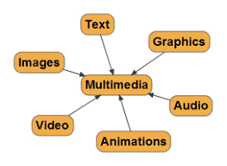
What is Multimedia?
The word multi and media are combined to form the word multimedia.
The word “multi” signifies “many.” Multimedia is a type of medium that allows information to be easily transferred from one location to another.
It is the presentation of text, pictures, audio, and video with links and tools that allow the user to navigate, engage, create, and communicate using a computer.

Slide 4

Representing Images
Digital images
A digital image is a representation of a real image as a set of numbers that can be stored and handled by a digital computer.
All images need to be converted into binary in order for a computer to process them so that they can be seen on our screen. Digital images are made up of pixels.
Each pixel in an image is made up of binary numbers.

Slide 5

What is a Pixel?
To store an image on a computer, the image is broken down into tiny elements called pixels. A pixel (short for picture element) and it is the smallest element found in a digital display or image. (Tiny dots that makes up an image or electronic display). Each of these unit/dot/elements represents one colour.
For the computer to store the image, each pixel is represented by a binary value. We call this representation of colours a “bit-plane”.
Digital image is of two types
Bitmap
Vector

Slide 6
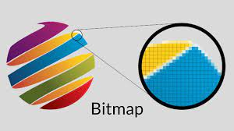
Bitmap Images
Bitmaps images are exactly what their name says they are: a collection of bits that form an image.
The bitmapped graphic (also called a bitmap or raster image) is made up of a grid of pixels.
A pixel (short for ‘picture element’) is the smallest element in an image. If you magnify an image, you will see that it is made up of these tiny elements.

Slide 7
Bitmap Images
Bitmap images are organized as a grid of coloured squares called pixels (short for 'picture elements'). Each pixel is actually a very small square that is assigned a color, and then arranged in a pattern to form the image.
All bitmap images comprises of individual pixel arranged in a grid where each pixel contains colour information

Slide 8
Pixel Representation
A pixel in a bitmap(raster)image is the smallest unit of the image and represents the smallest point in the image grid

Slide 9
Ways in which a pixel represented and encoded

Slide 10
Colour Depth
1 bit per pixel (0 or 1): two possible colours (Black and white)
2 bits per pixel (00 to 11): four possible colours (Red, Blue, Green White)
3 bits per pixel (000 to 111): eight possible colours
4 bits per pixel (0000 – 1111): 16 possible colours ………
16 bits per pixel (0000 0000 0000 0000 – 1111 1111 1111 1111): over 65 0000 possible colours
Colour depth is the number of bits used to represent the colour of a single pixel
The number of bits in a pixel will determine the range of colours or shades of gray a pixel can represent.
This is known as an image's colour depth.
Each bit doubles the number of available colours

Slide 11
Colour Model
Pixel in images are usually represented using colour models. The most common model are Red, Green Blue where each pixel is define by a combination of these three primary colours.
Other colours include CMYK (Cyan, magenta, Yellow, key/Black for print or gray scale for black and white images

Slide 12
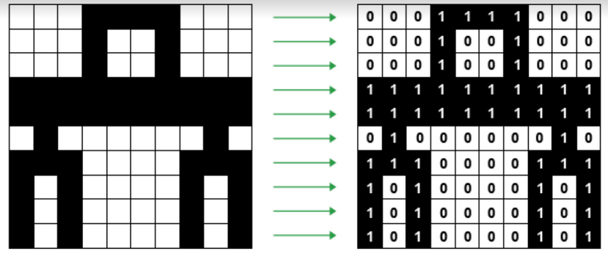
To create the picture, a grid can be set out and the squares coloured (1 – black and 0 – white). In order for the computer to interpret the image (create the grid) it has to have what is called metadata.

Slide 13
What is Metadata?
The metadata is found at the beginning of the file in an area that is referred to as the file header.
It contains information or data that is associated with the image file It is essential for organizing, managing and understanding bitmap images.
Metadata includes the file header with data about the file itself, such as:
file type
date created
author
including image size
number of colours, etc.
An image file also includes metadata about the image data itself, such as:
the height and width of the image - this defines how many rows and columns the pixels are to be arranged in.
the resolution
the colour depth

Slide 14
Digital Image Resolution
Resolution is of two types
Image Resolution - how many pixels an image contains per inch/cm
Screen Resolution - the number of pixels per row by the number of pixels per column

Slide 15
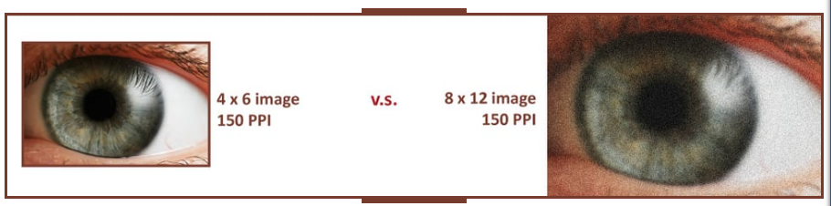
Image Resolution
Image quality is affected by the resolution of the image.
Image resolution can be defined as the level of detail in an image. this means that it refers to the number of pixels in a specific area of an image.
It is expressed as dots per inch (dpi), or pixels per inch (ppi).
72dpi = 72 dots per inch
200 ppi = 200 pixels per inch
A low-resolution image, the pixels are larger so less is needed to fill the space. Low resolution, or low-res, images will appear pixelated and blurred after printing because there is not enough pixels per inch to maintain a sharp image
The higher the resolution of an image, the larger its file size will be.

Slide 16
Screen Resolution
s a measure of the number of pixels that can be displayed on a screen or monitor.
It gives the level of detail and clarity in the visual output of a display device.
Screen resolution is expressed as the total number of pixels in the horizontal and vertical dimensions of the display area.
It is stated into two numbers called the pixel count e.g. 1920 x 1080
The first number represents the horizontal pixel count (the number of pixels from left to right), and the second number represents the vertical pixel count (the number of pixels from top to bottom).
To calculate the total number of pixels in a screen's resolution,
Multiply the horizontal and vertical pixel counts.
For example, what is the total pixel of a screen with a resolution of 1920x1080
1,920 * 1,080 pixels, = 2,073,600 pixels.

Slide 17
Screen Resolution
Common Resolutions: Some common screen resolutions include:
Full HD (1920x1080):
4K UHD (3840x2160): Also known as Ultra High Definition, it provides even greater detail and clarity.
720p (1280x720): A lower resolution often used for budget displays or smaller screens.
8K UHD (7680x4320): An emerging resolution that offers extremely high detail, primarily used in large and professional displays.
Graphics Quality: Higher screen resolutions generally result in better image quality and more detailed visuals. They are particularly important for tasks like video editing, gaming, and design work.
Compatibility: The screen resolution of a monitor or display must be supported by the graphics card or device connected to it. Mismatches can result in suboptimal display quality.
Scaling: On some devices, such as high-resolution laptops, scaling settings can be adjusted to make content more readable and visually appealing.

Slide 18
Screen Resolution
Pixel Density:
The pixel density or pixel per inch (PPI) is a measure of how densely packed the pixels are on a screen. Higher pixel densities result in sharper and more detailed images. Smaller screens with the same resolution as larger screens typically have higher pixel densities.
Aspect Ratio:
Screen resolutions are associated with specific aspect ratios, which represent the proportional relationship between the horizontal and vertical dimensions.
Example, the common Full HD resolution (1920x1080) has an aspect ratio of 16:9.
Common Rsolutions: Some common screen resolutions include:
Full HD (1920x1080):
4K UHD (3840x2160): Also known as Ultra High Definition, it provides even greater detail and clarity.
720p (1280x720): A lower resolution often used for budget displays or smaller screens.
8K UHD (7680x4320): An emerging resolution that offers extremely high detail, primarily used in large and professional displays.

Slide 19
How do we calculate the size of an image
To calculate the size of an image we have to take two primary factors in consideration: image resolution (in pixel) and colour depth (in bits per pixel). The size of an image file is typical measured in bytes (kilobytes, megabytes ect)
Formula
image size in bytes = width (in pixel) * height * color depth (in bits) /8

Slide 20
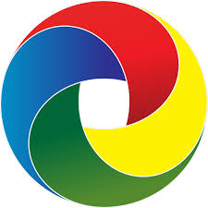
VECTOR IMAGE
Vector graphics are made from geometric objects such as circles and polygons.
Vector images are edited by manipulating the lines and curves that make up the image using a program such as Adobe Illustrator. These images tend to be smaller than bitmap images because a bitmap image has to store color information for each individual pixel that forms the image, with the vector image it just has to store the mathematical formulas that make up the image, which take up less space.

Slide 21
Drawing Object (in Vector Images):
A drawing object is a discrete graphical element or entity within a vector image that is defined by its geometric properties (e.g., position, size, shape) and attributes (e.g., color, stroke, fill).
Each drawing object represents a specific visual component within the vector graphic and can be manipulated, styled, and edited independently.
Drawing objects are organized within the vector image's structure and are used to create complex illustrations, diagrams, and designs with precision and scalability.
They can be created and edited using vector graphics software, which allows designers and illustrators to work with individual elements to create intricate and versatile visual

Slide 22
Drawing Object (in Vector Images):
A drawing object has the following properties which are encoded as data values associated with each drawing object.
Position: The coordinates specifying the object's location.
Size: Dimensions determining the object's width and height.
Color: Attributes defining the object's stroke and fill colors.
Line Thickness: Property indicating the width of object outlines.
Transparency: Information about the object's opacity or transparency level.

Slide 23
Drawing List: (in Vector Images):
A drawing list is a sequence of instructions or commands that describe how to render a vector graphic.
Unlike raster images, which are composed of individual pixels and store color information for each pixel, vector images are composed of geometric shapes and paths defined by mathematical equations.

Slide 24
Drawing List: (in Vector Images):
Vector graphics file formats, such as SVG (Scalable Vector Graphics), AI (Adobe Illustrator), EPS (Encapsulated PostScript), and PDF (Portable Document Format), typically store the drawing list as a set of instructions or XML data. This format allows vector images to be scaled to any size without loss of quality because the rendering software can recreate the image based on the mathematical descriptions in the drawing list.

Slide 25
Drawing List: (in Vector Images):
The drawing list is an essential component of vector images because it separates the image's structure and content from its appearance. This separation of content and appearance makes vector images highly scalable and versatile, as they can be easily edited, resized, and adapted for various output devices and media without loss of quality.

Slide 26
The characteristics of Vector Graphics
Vector images are formed from a combination of individual objects consisting of points, lines and colors.
Image size does not affect the quality of the displayed image, because it does not depend on image resolution.
Has a relatively small size for the image file
It is scalable so it won’t break when the image is enlarged
The resulting image display is less real and natural, so it cannot be used to produce realistic photo images.
When displayed to the monitor screen requires a longer process.

Slide 27
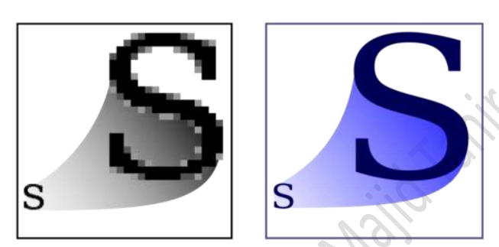
Comparison Between Vector and Bitmaps

